Slide 1

Fast, easy and reliable payment solutions with cryptocurrency

Slide 2


MISSION
To be the global leader in payment solutions using crypto
VISION
To be the global leader in payment solutions using crypto

Slide 3
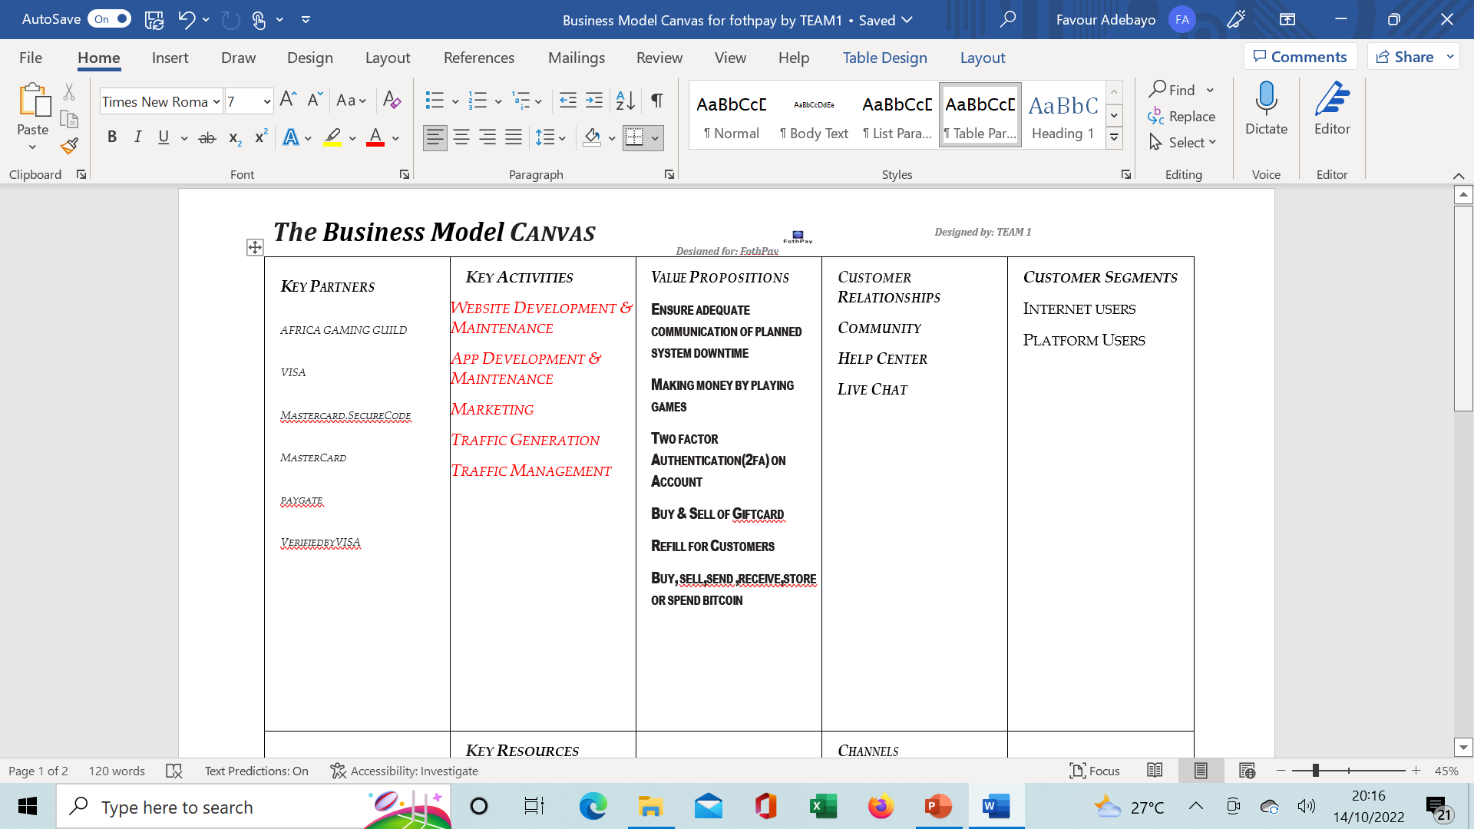
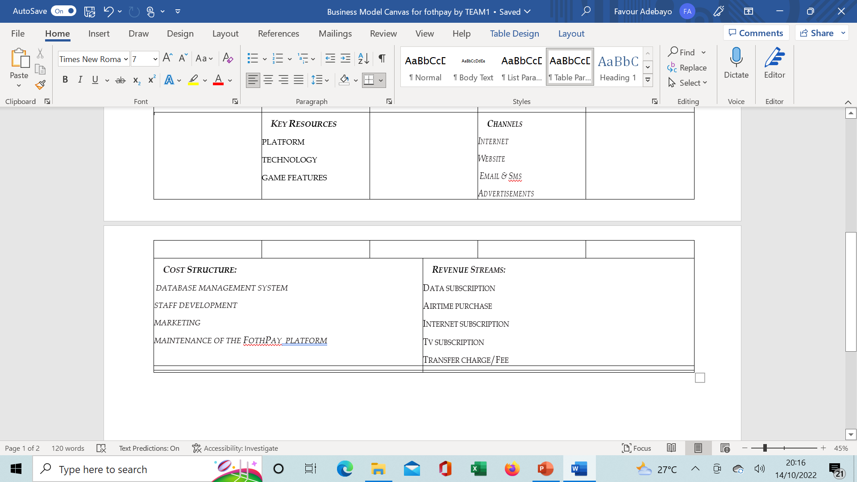
BUSINESS MODEL CANVAS

Slide 4
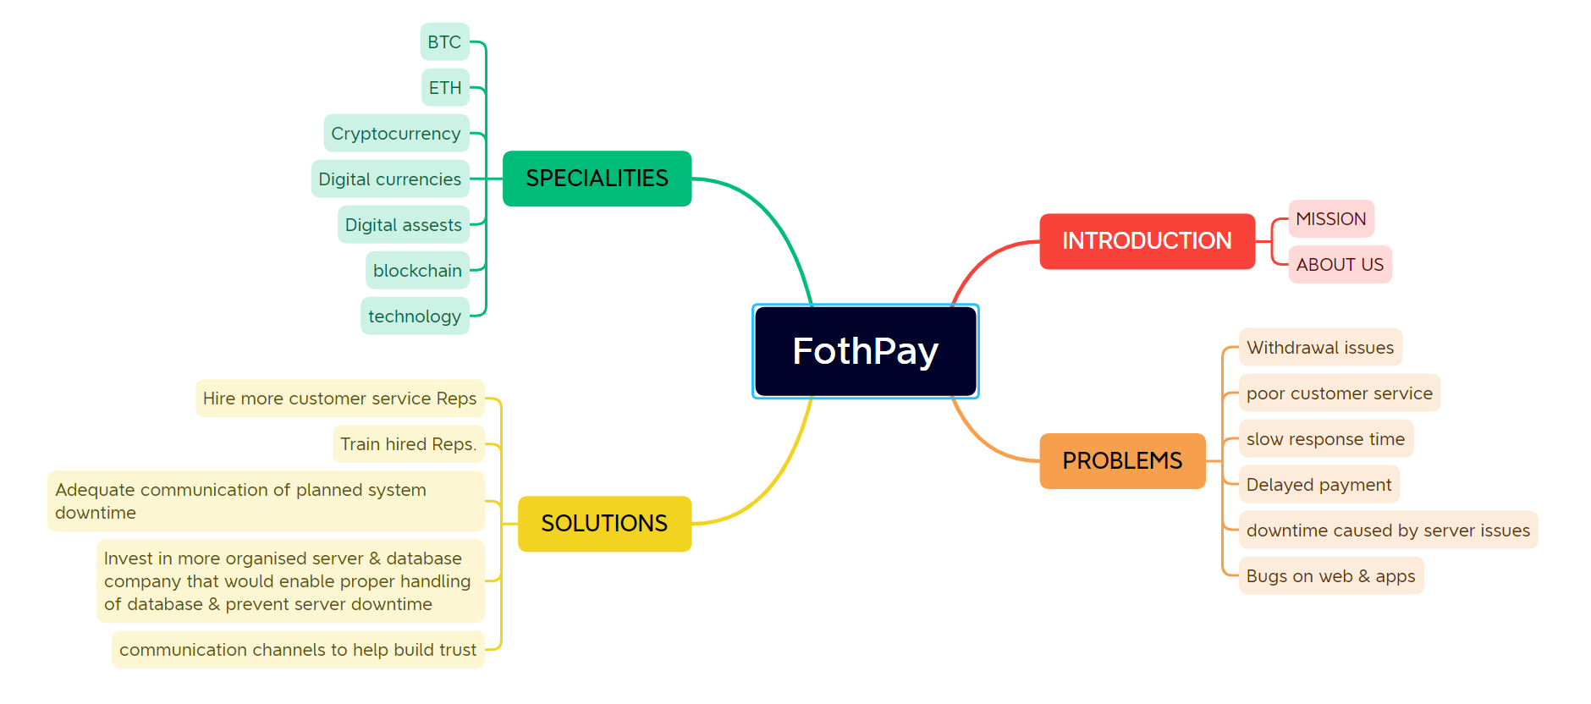
MIND MAP

Slide 5
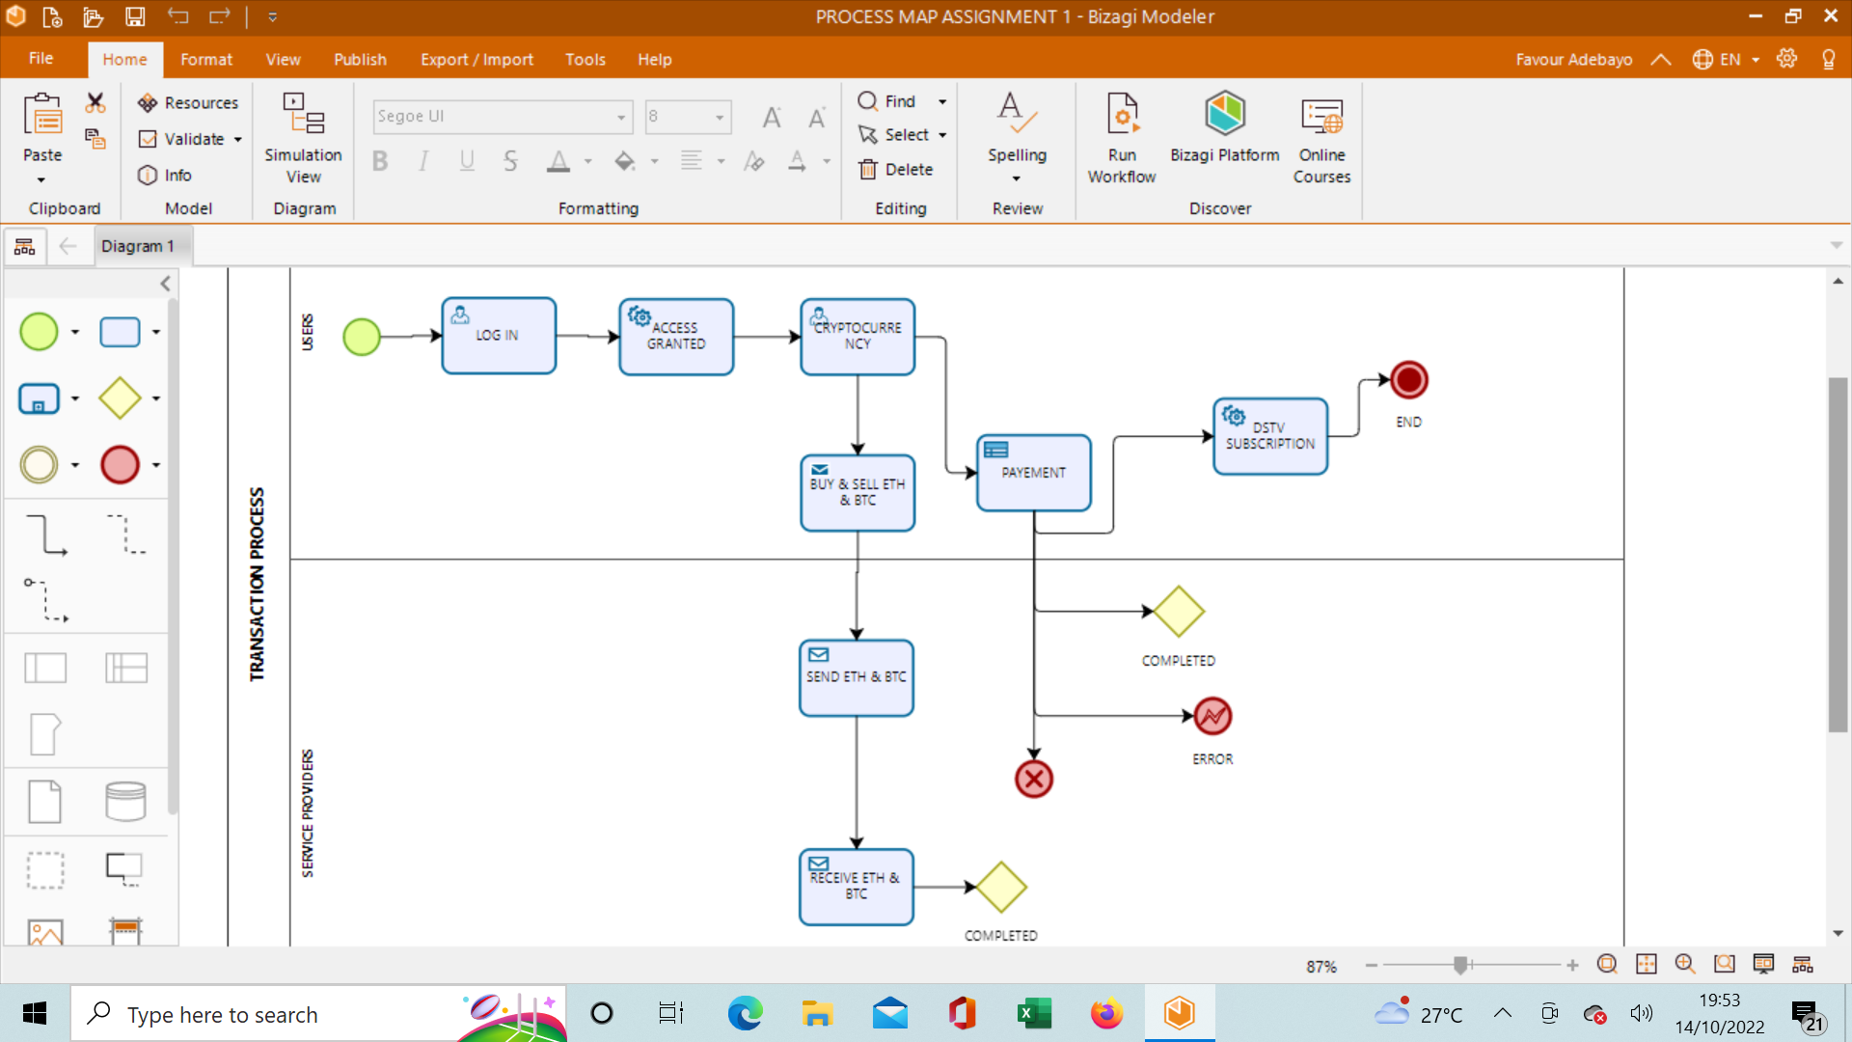
PROCESS MAP

Slide 6
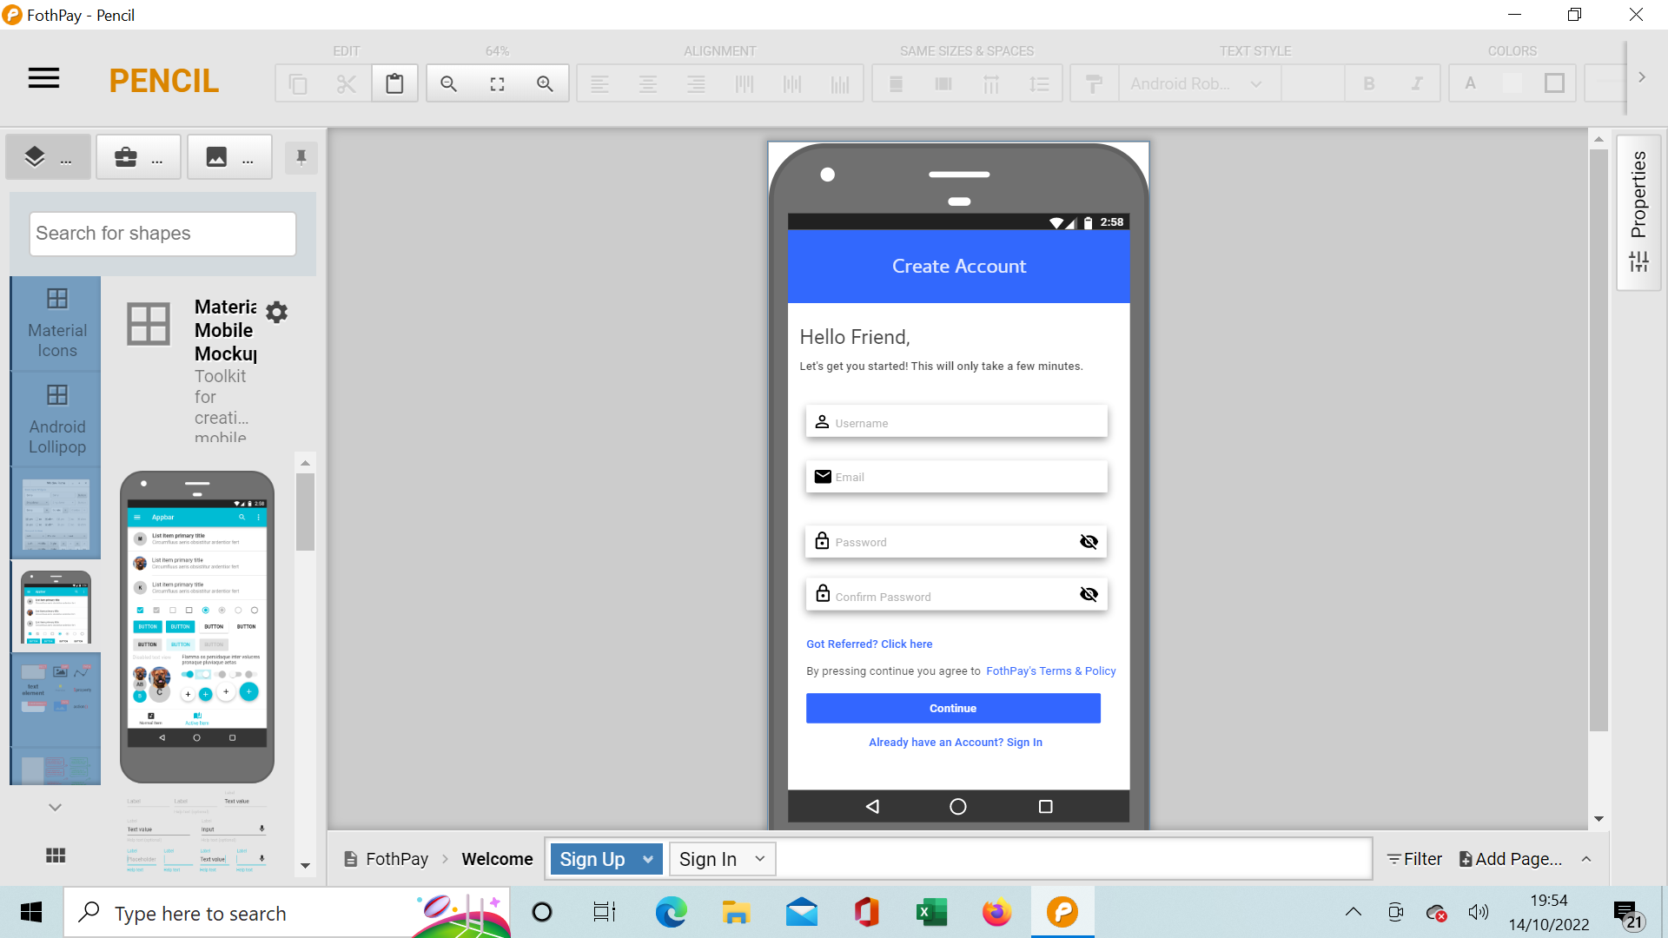
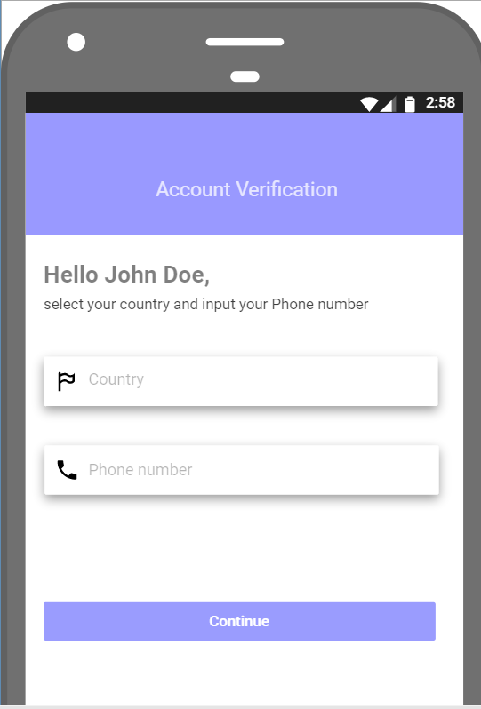
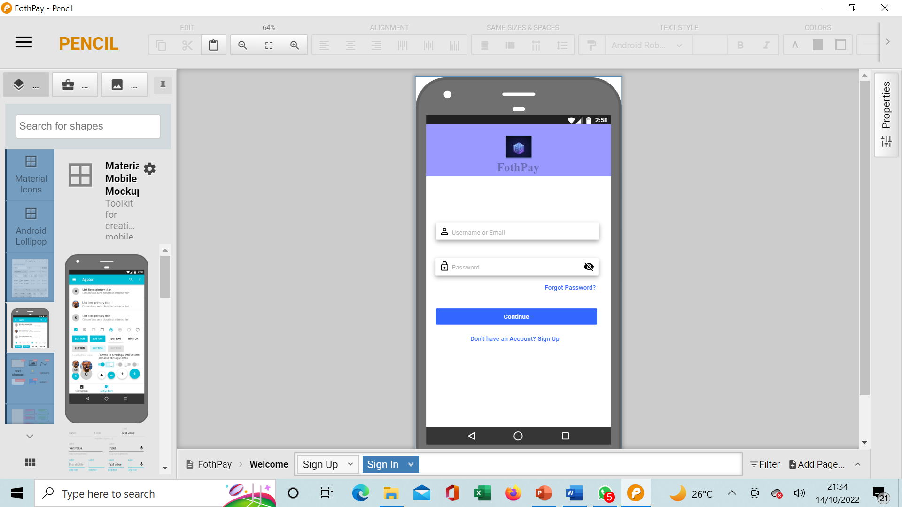
USER INTERFACE PROTOTYPE

